Slide 1
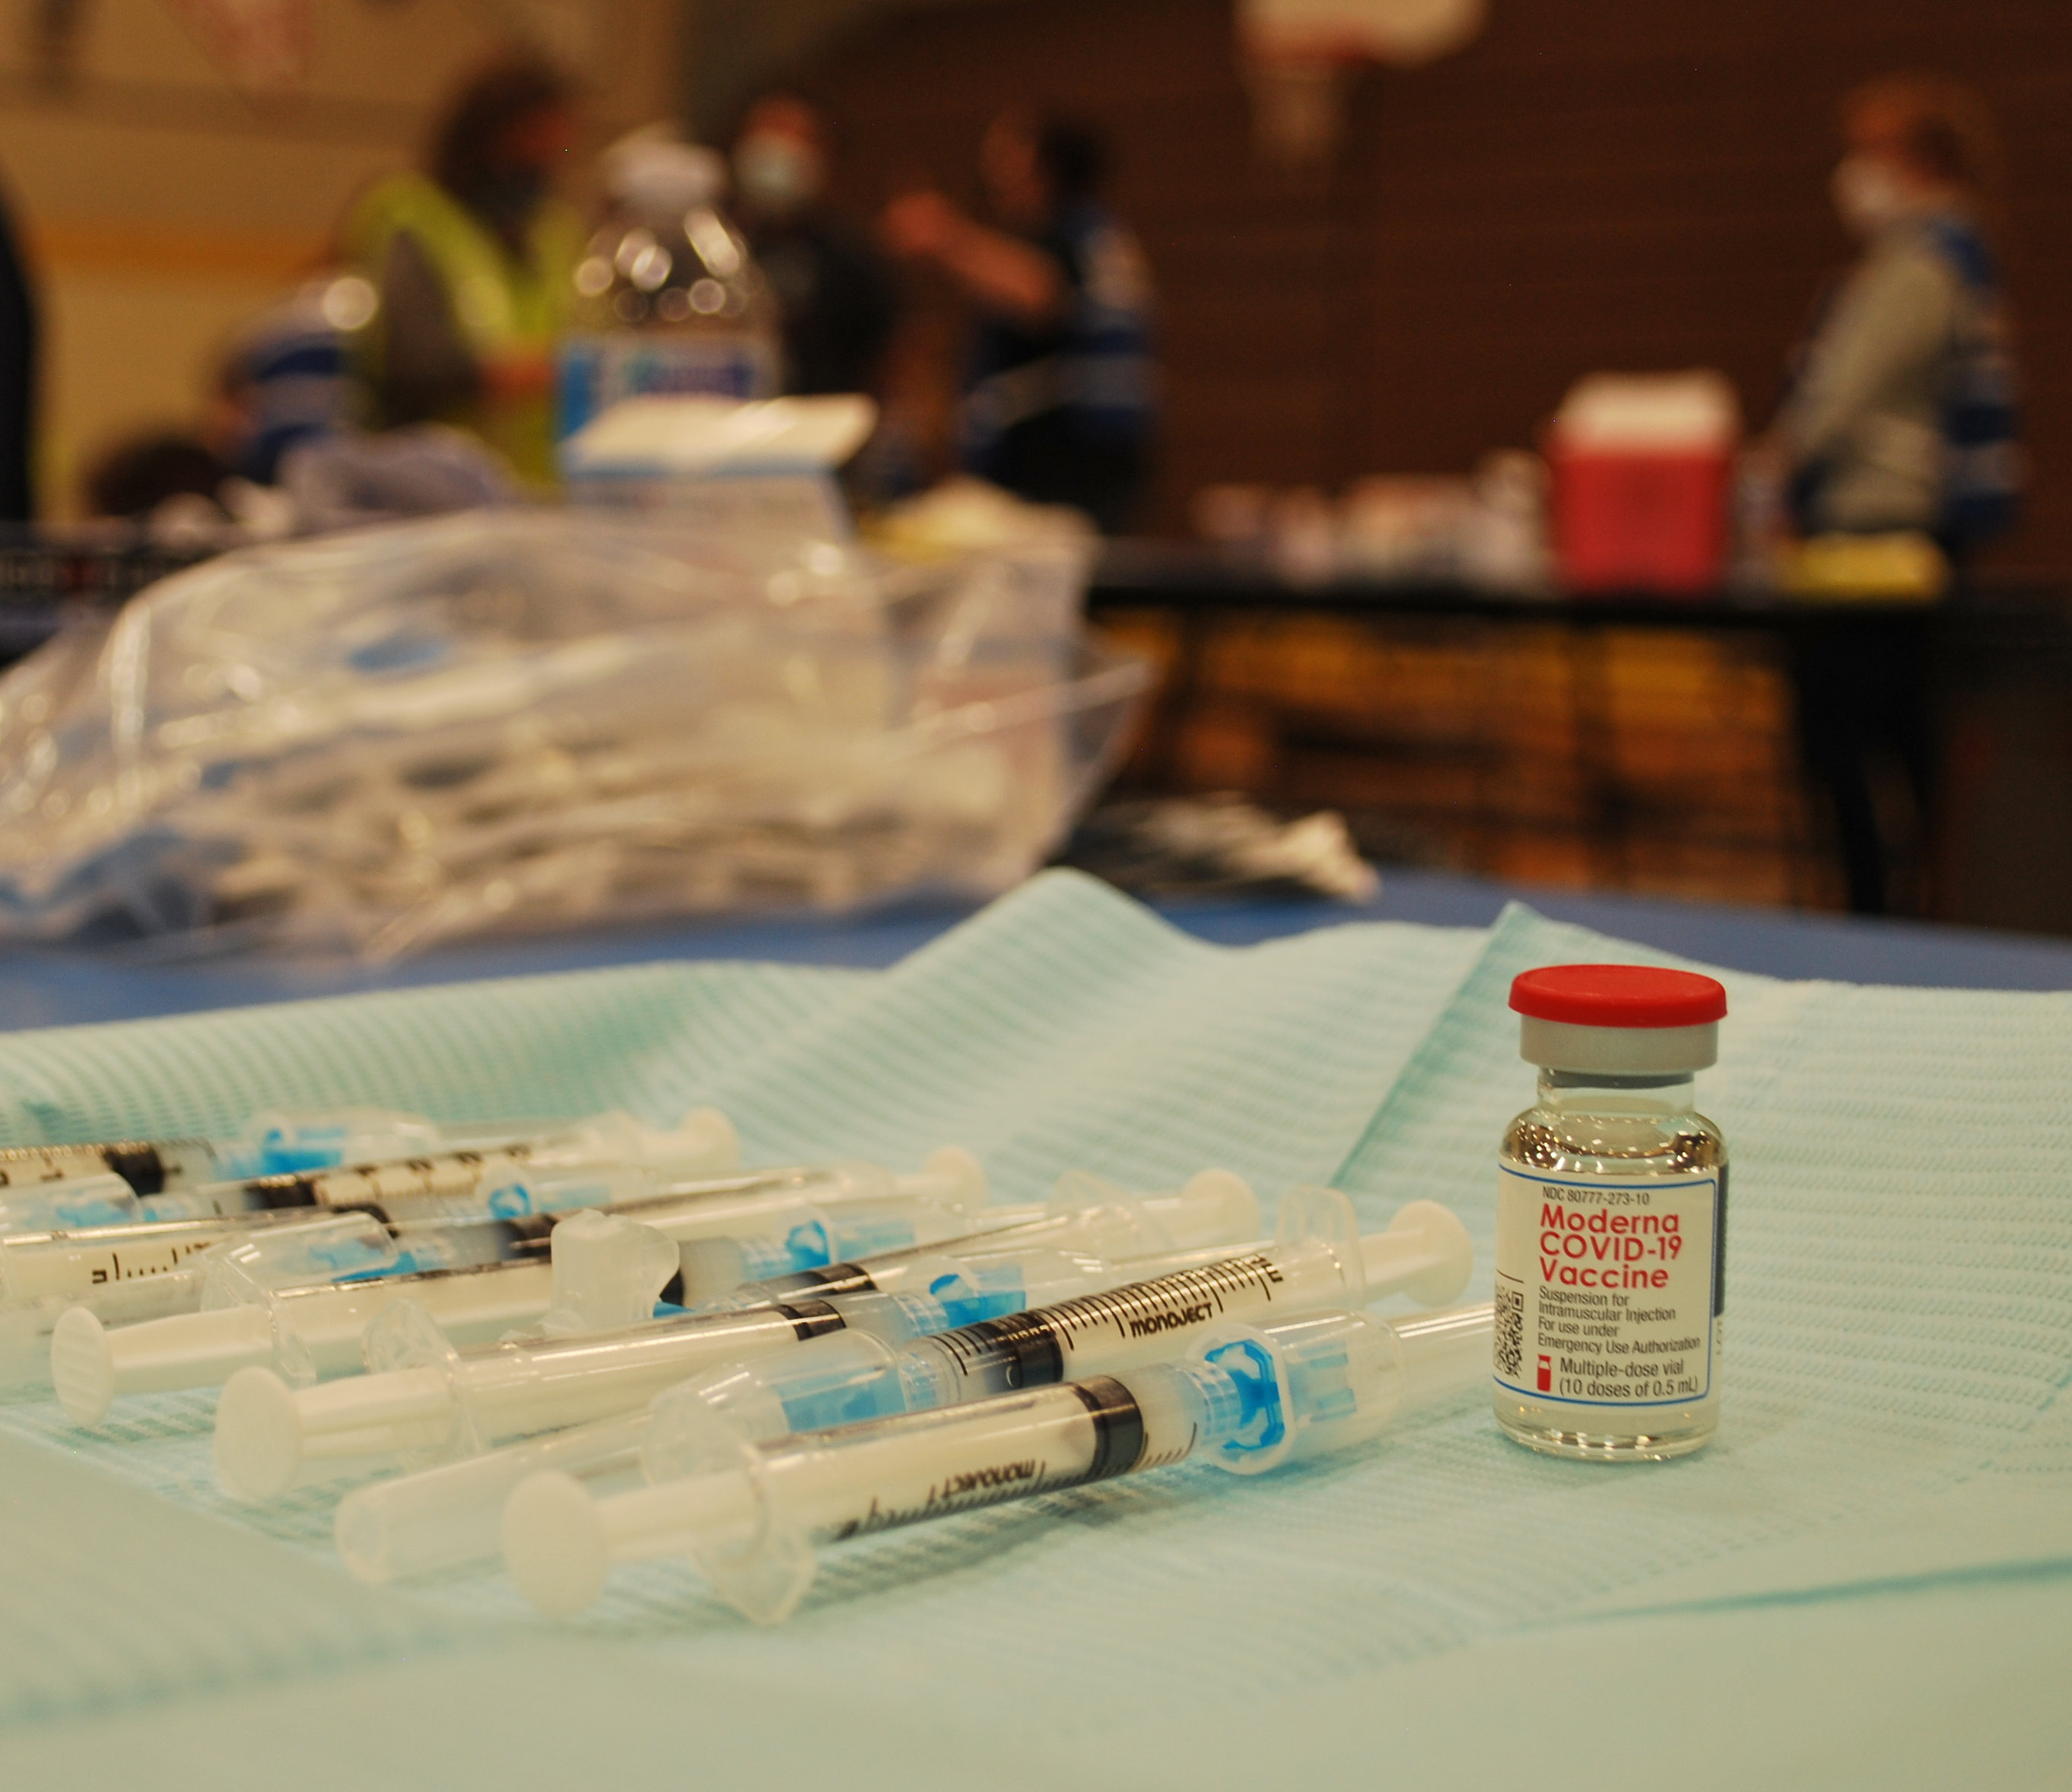
Sparks Fire Department Covid-19 Vaccination Efforts

Slide 2
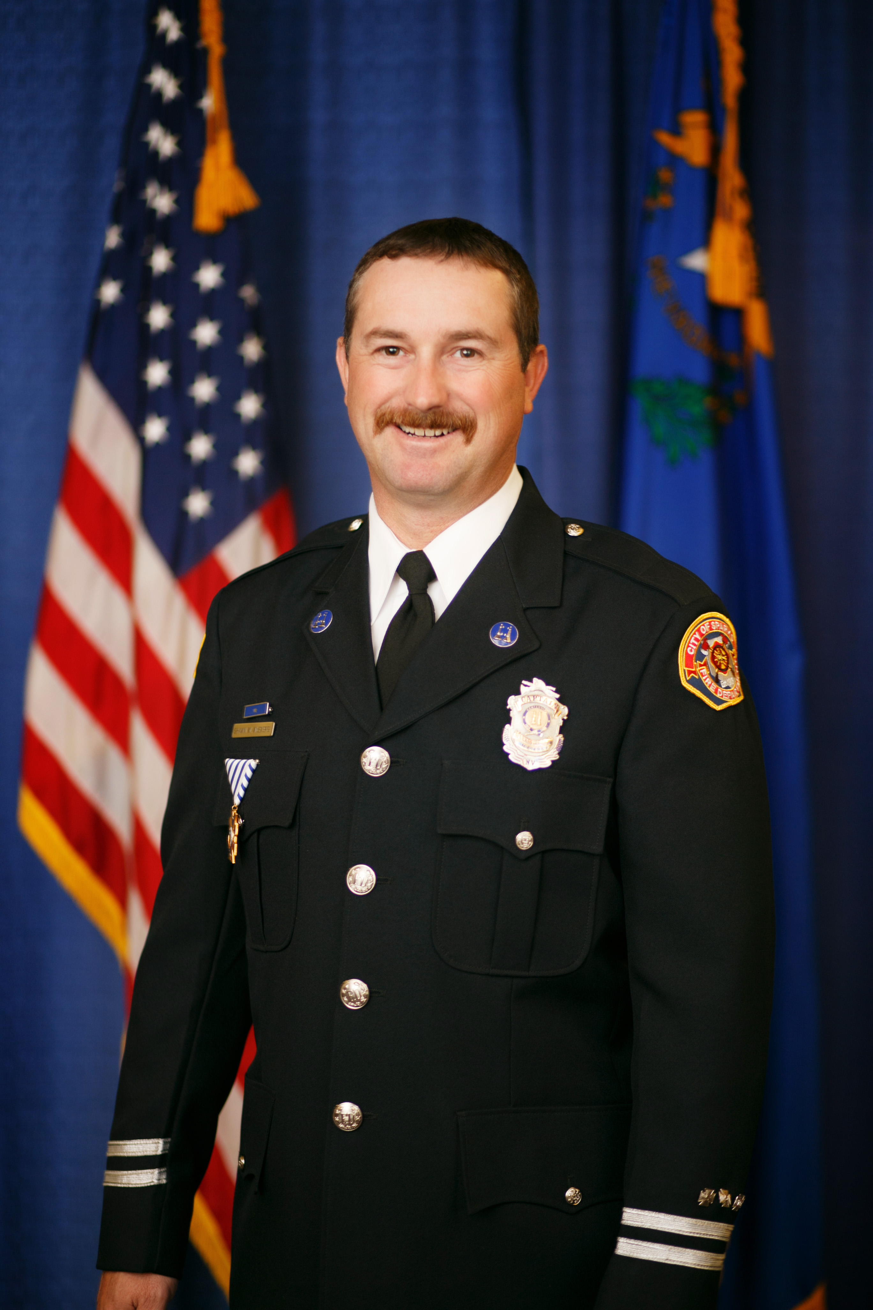
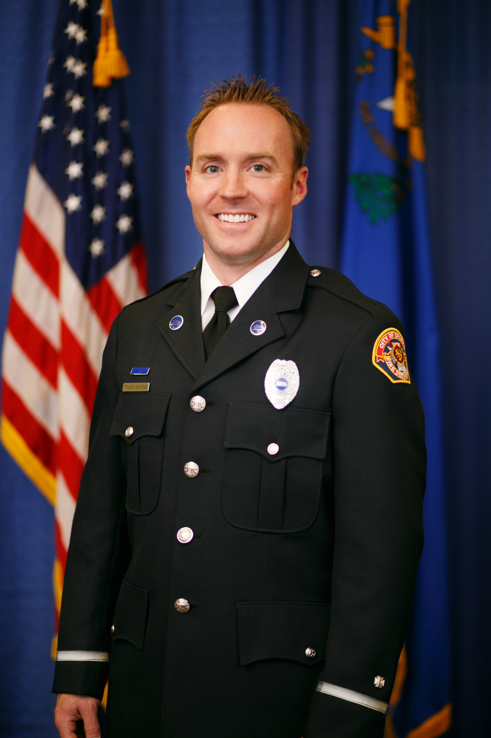
Presenters
Division Chief Shawn McEvers
Captain Tyler Gayton

Slide 3
Background
Implementing City of Sparks Point of Dispensing Plan (POD) - November 2020
Nevada’s COVID-19 Vaccination Playbook – Prioritization lanes.
Vaccinating city employees and general population.
Sparks Fire Department, Washoe County Health District and NV Department of Health and Human Services (DHHS)
Vaccine Coordinator late December 2020 – Captain Gayton

Slide 4
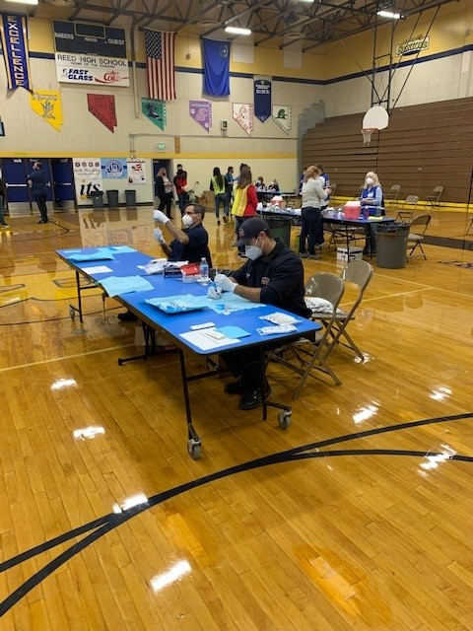
The Numbers
1 Division Chief of Administration
1 Vaccine Coordinator
3 Dedicated Data Entry Personnel (LD)
4 Additional Data Entry Personnel
12 Vaccinators and EMS/Recovery Standby
Numerous WCHD Volunteers
Two to three times a week, as necessary.
Sparks Parks and Recreation Building and Alf Sorensen Community Center.
City Employees, WCSD, TMWA, Daycares, Nugget, retirees, and general population. 605 S. 21st Street working with RFD.

Slide 5
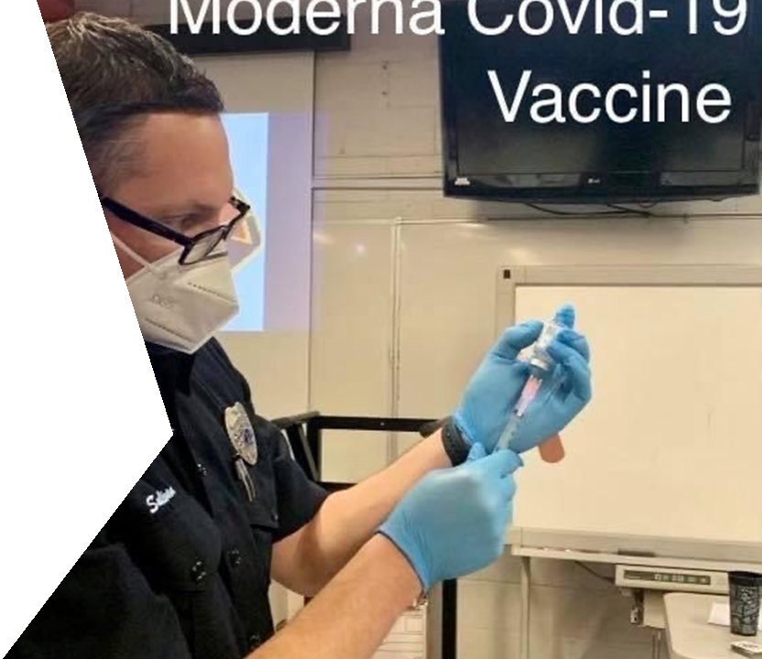
Vaccines as of April 10th, 2021
33 total PODS – all Moderna
3,728 Total Vaccinations
2,345 Fully Vaccinated
1,383 First Dose Received
All city employee groups
6 More PODS Scheduled through April
Estimated 4,500 Total Vaccines
Approaching 35% total vaccinations in Washoe County
Standby list for extra doses

Slide 6
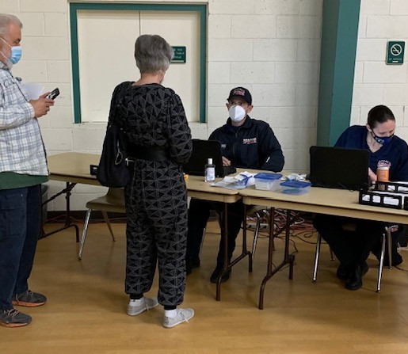
Moving forward
Second dose PODS through mid-April.
First dose PODS week of April 19th (2)
Nugget PODS.
Community Outreach PODS.
Large Scale Regional POD.
Opening of General Population April 5th.

Slide 7
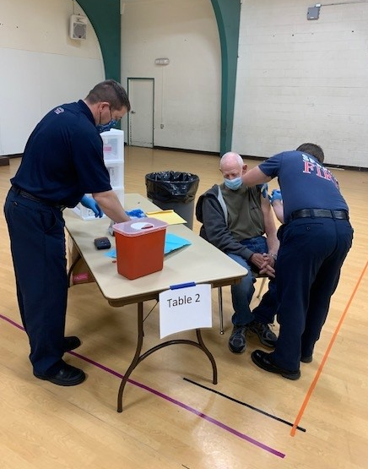
Any Questions?

